Slide 1
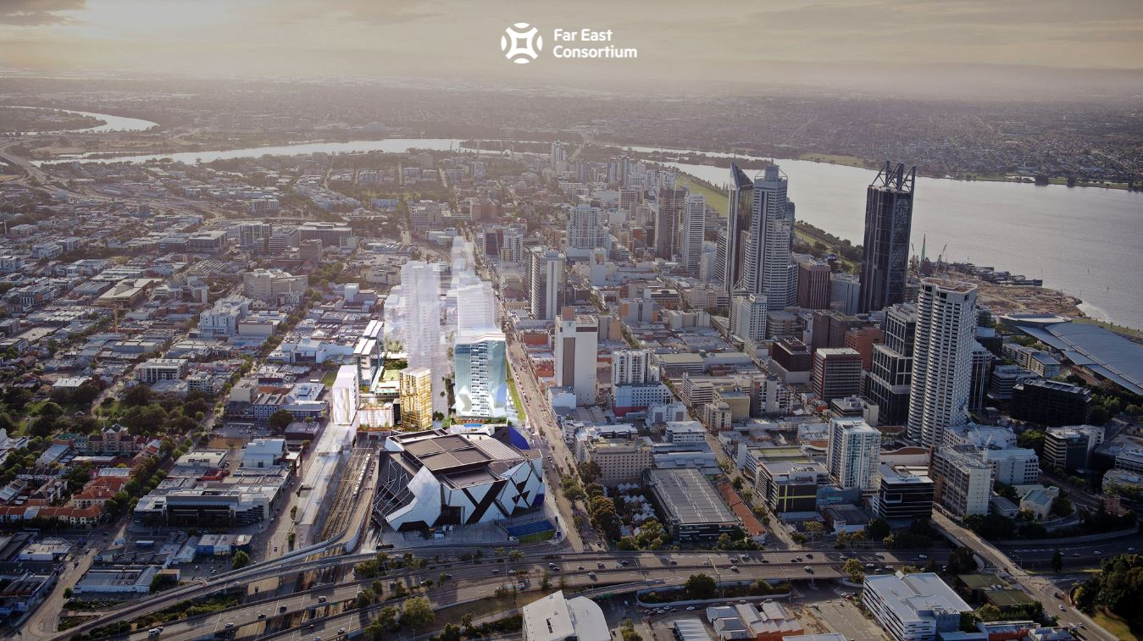

Slide 2
PERTH NEWS
“Price growth in the Perth metro area will out pace Sydney”
“Rental demand in Perth is growing at a far stronger rate than in Sydney and Melbourne and is now up almost 40 per cent since last year”
1 March 2018, The Australian
“The main reason Western Australia, and Perth in particular, has enjoyed consistent strong rates of growth in property markets is our equally strong population growth coupled with a strong local economy that continues to generate new jobs”
30 July 2018, The West Australian
“Perth itself is transforming and evolving as it experiences the highest population growth in Australia in the past 10 years.”
23 March 2018, The Guardian
“The time to capitalise on the investment opportunities in Perth is now, arming investors, business owners and entrepreneurs with the tools they need to make their move and leverage off Perth's competitive advantage as the seventh most liveable city in the world.”
“ Combined with our unique position as the gateway to the AsiaPacific region and sharing the same time zone as 60 per cent of the world's population, Perth is on track to become Australia's third largest capital city by 2036”
22 December 2017, The West Australian
“It’s no coincidence that there has been a boom in apartment building at precisely the same time as Perth city has become a far more exciting place to live.” 23 July 2018, Domain

Slide 3
PERTH INFRASTRUCTURE PROJECTS
Perth’s population is expected to double to 4 Million over the next 30 years,
passing Brisbane to become Australia’s 3rd largest city.
Infrastructure spending has been boosted to keep pace:
Perth Major Projects:
Fiona Stanley Hospital - $1.76B
Perth Children’s Hospital - $1.2B
Metronet Rail - $5.4B
Perth Airport Road & Rail - $2.46B
Perth Stadium - $1.8B
Perth Museum - $430M
20 new hotels - $2.1B
Airport Expansion - $2.5B
Perth City Link (Inc. Perth Arena and Yagan Square) - $1.36B
Elizabeth Quay - $440M
Retail - $3B
Lithium Processing - $3B
Patrol Boat Construction - $3.5B
As Perth’s population expands we expect transport times from outer suburbs to
lengthen.
At the same time new attractions like entertainment precinct Perth City Link
will make inner-city living more attractive. Perth will follow other major
Australian Cities with a much higher inner-city population.

Slide 4
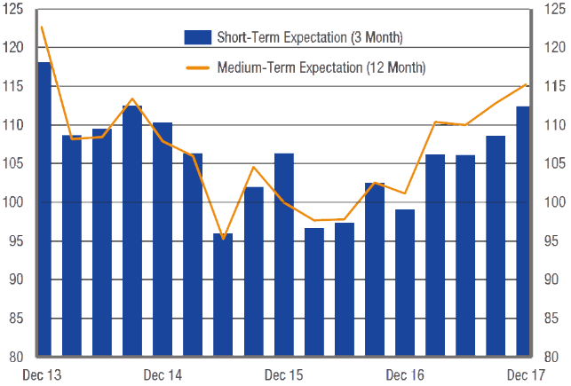
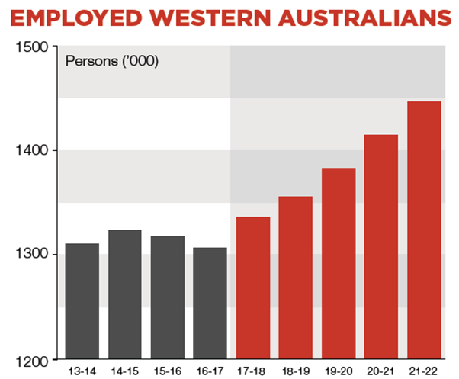
PERTH INVESTMENT HIGHLIGHTS
WESTERN AUSTRALIA POPULATION GROWTH
EMPLOYMENT GROWTH
Over 2018-19, around 50,000 jobs are expected to be created.
CONSUMER CONFIDENCE
Consumer Confidence in WA, December 2017
Source: Australian Bureau of Statistics
Source: WA State Budget

Slide 5
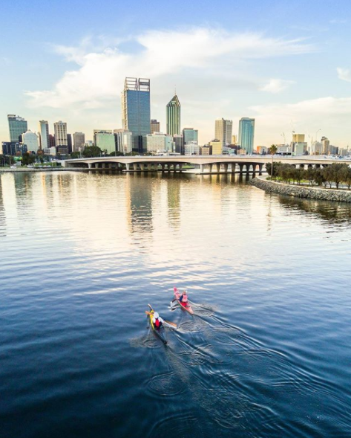
PERTH ECONOMIC FACTS
Perth shares a time zone with 60% of the world’s population. Among these countries are most of WA’s key economic partners including China, Japan, South Korea and Indonesia.
Perth has the largest concentration of global resources companies in Australia, drawn in by the state’s mineral wealth, vibrant economy, attractive investment climate, low sovereign risk and highly skilled local workforce.
The value of exports generated by the WA economy is estimated at $52 billion (41% of national exports). Main exports include iron ore, oil & gas, aluminium, gold, diamonds, lithium, nickel, zinc, cobalt, mineral sands, wheat, beef.
New resource projects planned total $57bn (oil & gas $43bn, iron ore $8bn, lithium $5.7bn).
Perth population growth second fastest for Australian capital cities.
Major companies like BHP, Rio Tinto and Woodside’s annual profit dominated by their WA business units.
Source: Government of Western Australia

Slide 6
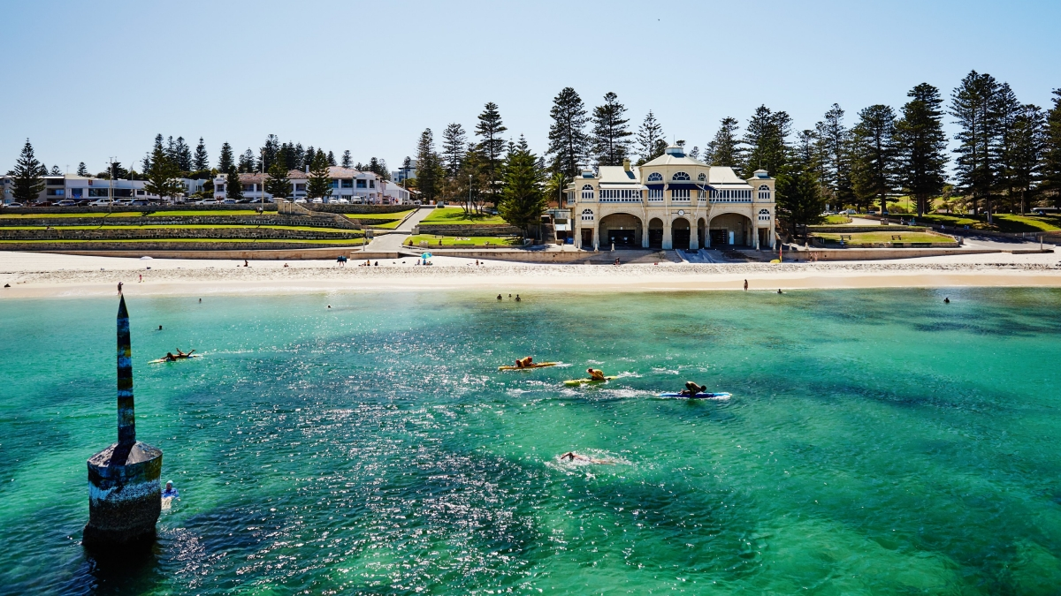
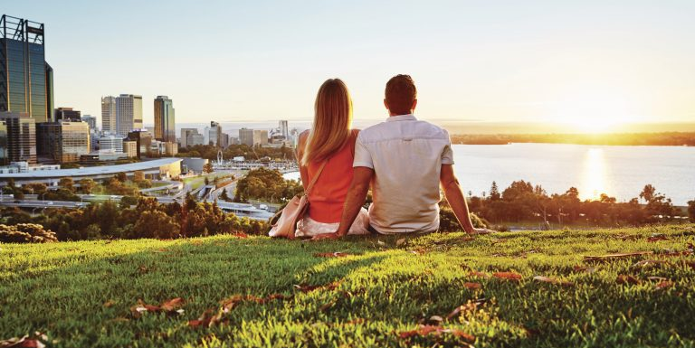
PERTH TOURISM
Perth welcomes close to 2.4 million international and domestic visitors per year contributing to $3.6 billion of expenditure.
WA enjoys more hours of sunshine than any other capital city in Australia.
WA boasts over 12,500 km of beautiful coastline.
Looking at WA’s top 10 international markets, in the year ending March 2018 there was strong growth in the number of visitors to WA from:
China (+8.6% visitors)
India (+12.0% visitors)
Japan (+9.9% visitors)
USA (+3.1% visitors)
In 2016–17, direct tourism in Western Australia was worth $6.1 billion to the economy (+2.0% compared to 2015–16).
With 20 new hotels open or under construction tourism is expected to be a big contributor to our economy.
Source: Tourism WA

Slide 7
PERTH INTERNATIONAL STUDENTS
Perth has four universities with campus locations spread across inner and outer suburbs. All universities are accessible by train or bus from Perth Hub. Perth Hub offers convenience and safety for students in the heart of the City with direct access to Perth’s entertainment district.
University of Western Australia (5.5km from Perth Hub)
UWA is Perth’s most prestigious university and is ranked as one of Australia’s best. UWA is 15minutes by bus from the city centre and King’s Park.
International enrolments – 5,241
International % of enrolments - 20.5%
Curtin University (9.8km from Perth Hub)
Curtin University is easily Perth’s largest, with around 40,000 students. More than a third of them are from overseas. The university has a strong reputation for research internationally and has facilities in Sydney and Asia. Its main campus is in Bentley, 8 km south-east of the CBD.
International enrolments - 15,598
International % - 32.3%
Murdoch University (16km from Perth Hub)
Murdoch University is based at a large rural property in Perth’s southern suburbs. The university accepts large numbers of international students at the undergraduate level. Close to half of the students are studying abroad in Australia.
International enrolments - 9,809
International % - 40.6%
Edith Cowan University (25km from Perth Hub)
ECU has its main campus at Joondalup in Perth’s northern outskirts. It also has an inner city campus. The university is teaching focused and achieves high course ratings.
International enrolments– 4,239
International % - 16%
Source: Australian Universities Website

Slide 8
PERTH CITY LINK
Perth’s amazing new living and lifestyle precinct is coming to life.
Transport and entertainment infrastructure is complete.
Far East Consortium launch their Dorsett Hotel and Perth Hub residential tower, to be built together bringing residents and tourists to City Link.
Perth City Link connects Perth’s CBD with entertainment precinct Northbridge.
The area, once just a network of bus and train connections, will boast new transport and pedestrian connections, hotels, apartments and offices, changing the way residents interact with the city.
Once complete, the area will become a world-class entertainment precinct and transit hub.
Community facilities on offer including a 24-hour gym and childcare.
Source: Metropolitan Redevelopment Authority

Slide 9
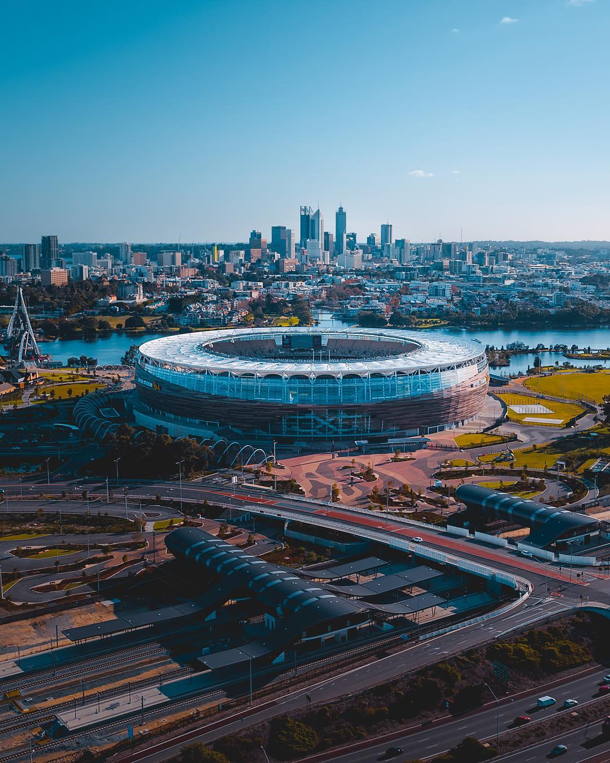
OPTUS STADIUM:
4.4km from Perth Hub, direct bus and train connections available.
The stadium has a capacity of 60,000 people, making it the third largest stadium in Australia.
Primarily used for Football and Cricket, whilst also hosting major concerts and other entertainment events.
The stadium boasts the widest range of seating and hospitality options of any stadium in Australia.
Optus Stadium is accessible via public transport, with its own six-platform Stadium Train Station and the Swan River Pedestrian Bridge.
The stadium is 400m from Crown Perth Casino.
Source: Optus Stadium Website

Slide 10
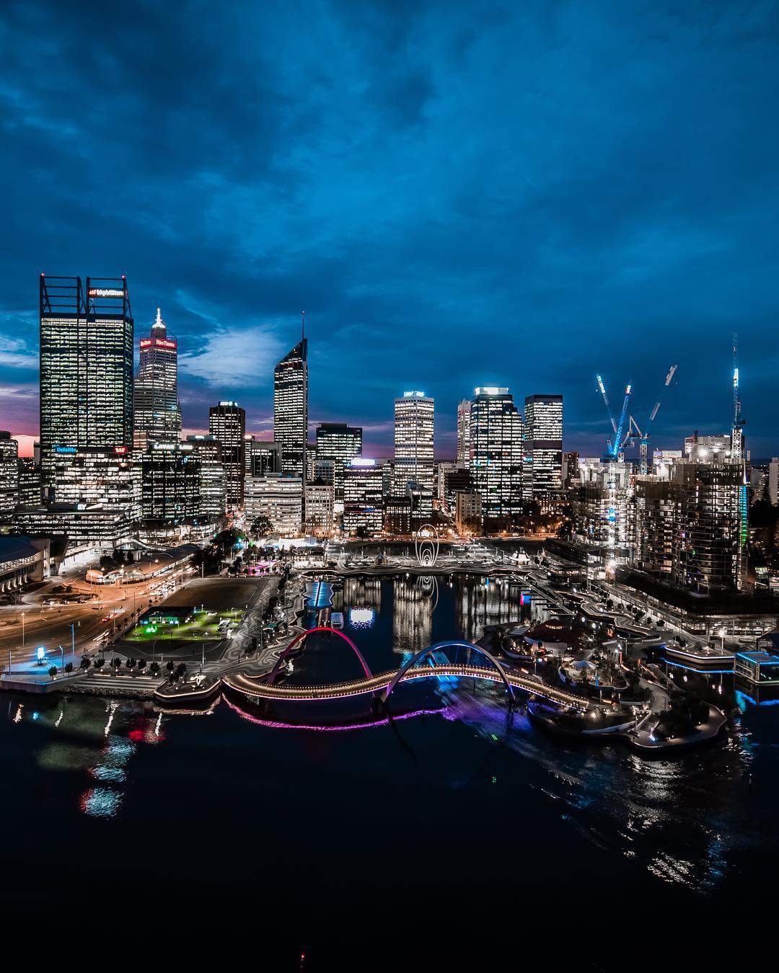
ELIZABETH QUAY
1.1km from Perth Hub, direct bus and train connections available.
Elizabeth Quay is part of a bold plan by the Western Australian Government to revitalize central Perth.
Featuring a 2.7ha inlet surrounded by offices, shops, bars and restaurants, the project has returned the city’s focus to the Swan River and provided a contemporary waterfront destination for Perth.
On completion it is estimated there will be around 150,000 square metres of office space and 39,000 square metres of retail space.
The State Government committed $440million to fund construction of the inlet, roads and services, public domain and the creation of development sites.
Far East Consortium are currently constructing the luxury Towers at Elizabeth Quay and Ritz-Carlton hotel. US oil company Chevron will be the next building to start with a new $1billion glamour tower to house their 4-5,000 Perth staff.
There are plenty of public transport options, with The Elizabeth Quay Bus Station, railway station and ferries to and from South Perth.
Source: Metropolitan Redevelopment Authority

Slide 11
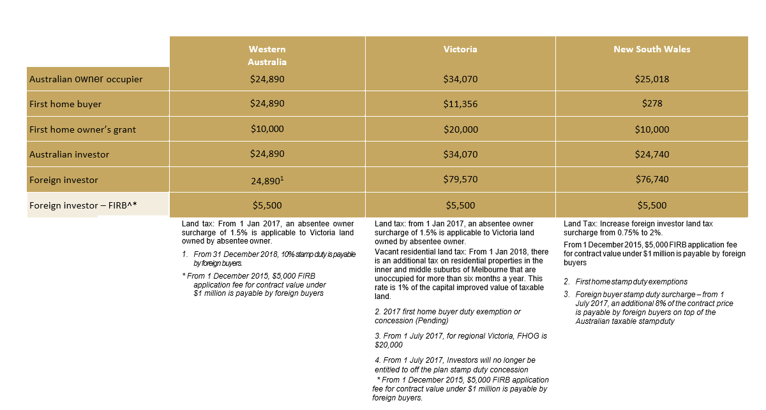
STAMP DUTY COMPARISONS
Based on an off-the-plan purchase of a $650,000 apartment with $200,000 dutiable value on land.
Stamp duty – Post July 2018
Changes in off-the-plan stamp duty: As of the 31st of December, 2018 – Stamp duty will increase by 7% for all international purchasers.

